Slide 1

greedy
Note: Please turn off your microphone and camera.
Mr. Gao's Algorithm
Competition Training Camp

Slide 2
What is a greedy algorithm?
Greedy algorithms are a problem-solving strategy that starts from the initial state of a problem and arrive at the optimal (or suboptimal) solution through several steps of greedy choices.
Each step yields a locally optimal or suboptimal solution in some sense.
Greedy algorithms cannot guarantee the globally optimal solution for all problems.
Advantages: Fast! Disadvantages: Only generates suboptimal overall solutions for most problems.
Correctness of greedy algorithms requires rigorous proof.
Greedy algorithms do not have a fixed algorithm framework; the key is the design of the greedy strategy.
Greedy decisions must be ‘no aftereffect’, and problems must have ‘optimal substructure’.

Slide 3
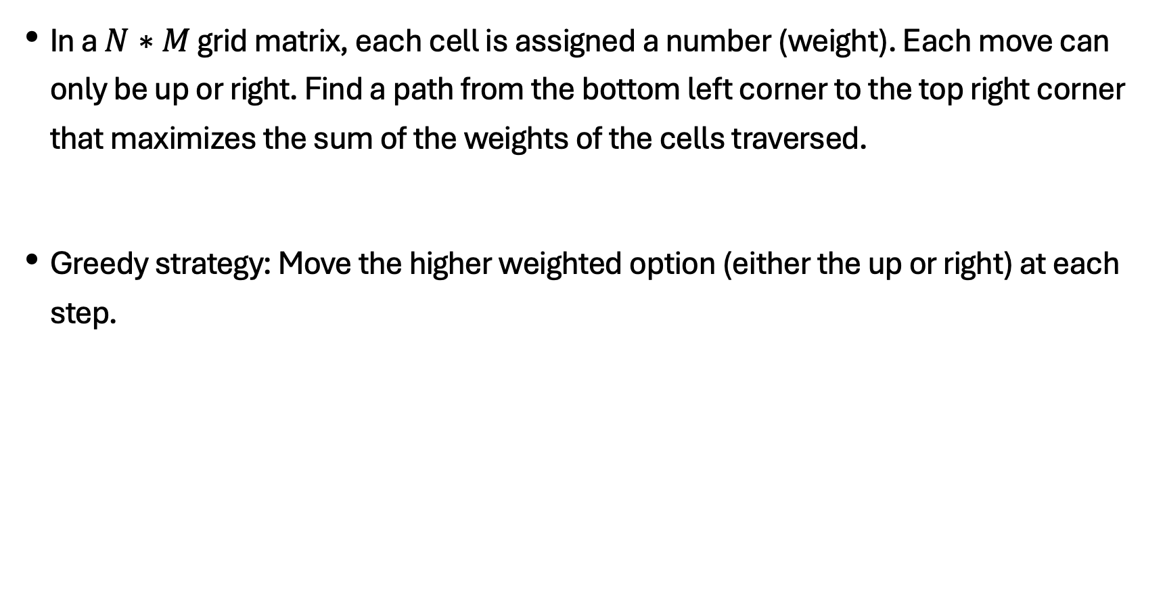
Choice of Optimal path
In a $N∗M$ grid matrix, each cell is assigned a number (weight). Each move can only be up or right. Find a path from the bottom left corner to the top right corner that maximizes the sum of the weights of the cells traversed.
Greedy strategy: Move the higher weighted option (either the up or right) at each step.
2 | 10 | 6
1 | 3 | 4
3 | 4 | 6
1 | 2 | 10

Slide 4

Optimal loading problem
Given $n$ objects, weight of the $i$-th object being $w_{i}$, select as many objects as possible such that the total weight does not exceed $C$.
Greedy strategy: Select in the ascending order of weight.

Slide 5
basic approach of greedy algorithms
Starting from an initial solution, proceed one step at a time according to a greedy strategy, ensuring that each step yields a locally optimal solution, targeting to obtain the globally optimal solution.
Process:
1. Establish a mathematical model to describe the problem.
2. Divide the problem into several subproblems.
3. Solve each subproblem to obtain a locally optimal solution.
4. Combine the locally optimal solutions of the subproblems into a single solution to the original problem.

Slide 6
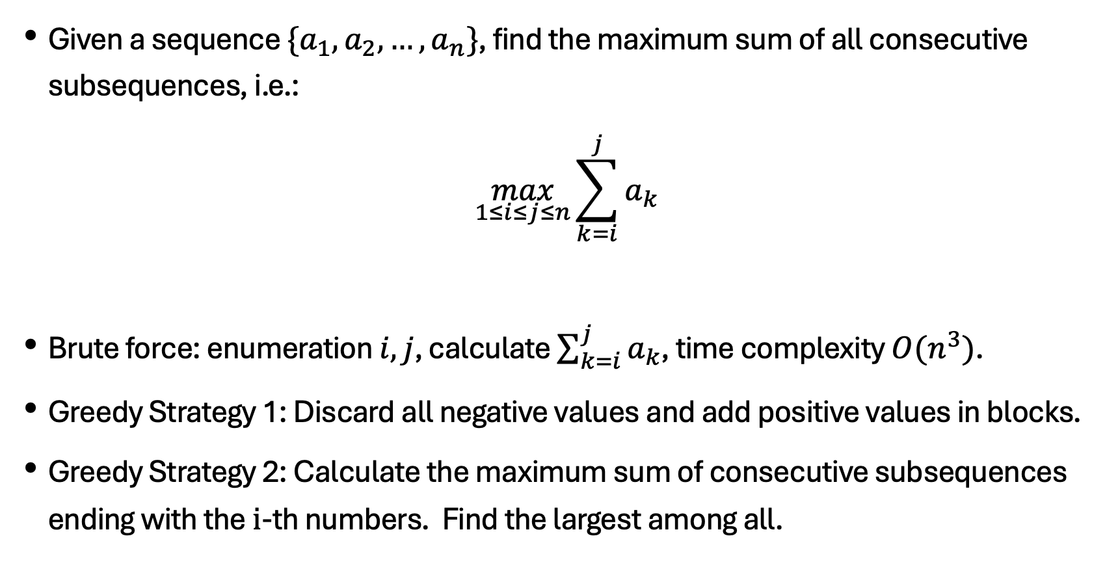
Maximum sum of consecutive subsequences
Given a sequence $\{a_{1},a_{2},…,a_{n}\}$, find the maximum sum of all consecutive subsequences, i.e.:
$$\max_{1≤i≤j≤n}{\sum_{k=i}^{j}{a_{k}}}$$
Brute force: enumeration $i,j$, calculate $\sum_{k=i}^{j}{a_{k}}$, time complexity $O(n^{3})$.
Greedy Strategy 1: Discard all negative values and add positive values in blocks.
Greedy Strategy 2: Calculate the maximum sum of consecutive subsequences ending with the $i$-th numbers. Find the largest among all.

Slide 7
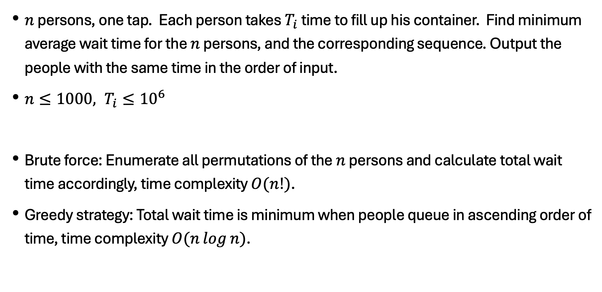
Queuing to get water
$n$ persons, one tap. Each person takes $T_{i}$ time to fill up his container. Find minimum average wait time for the $n$ persons, and the corresponding sequence. Output the people with the same time in the order of input.
$n≤1000, T_{i}≤{10}^{6}$
Brute force: Enumerate all permutations of the $n$ persons and calculate total wait time accordingly, time complexity $O(n!)$.
Greedy strategy: Total wait time is minimum when people queue in ascending order of time, time complexity $O(n\log{n})$.

Slide 8
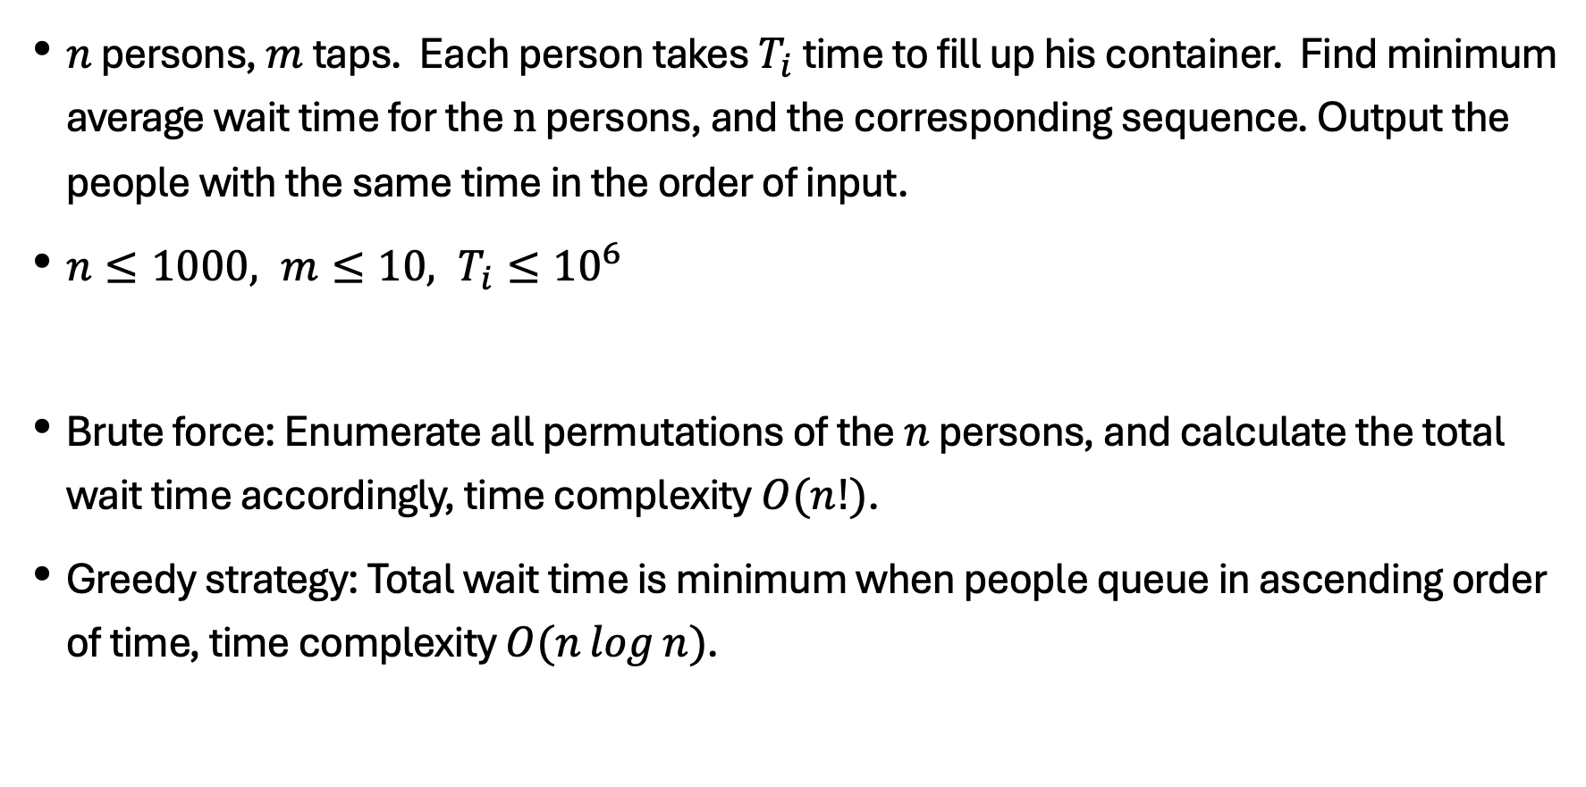
Queuing to get water
$n$ persons, $m$ taps. Each person takes $T_{i}$ time to fill up his container. Find minimum average wait time for the $n$ persons, and the corresponding sequence. Output the people with the same time in the order of input.
$n≤1000, m≤10, T_{i}≤{10}^{6}$
Brute force: Enumerate all permutations of the $n$ persons, and calculate the total wait time accordingly, time complexity $O(n!)$.
Greedy strategy: Total wait time is minimum when people queue in ascending order of time, time complexity $O(n\log{n})$.

Slide 9
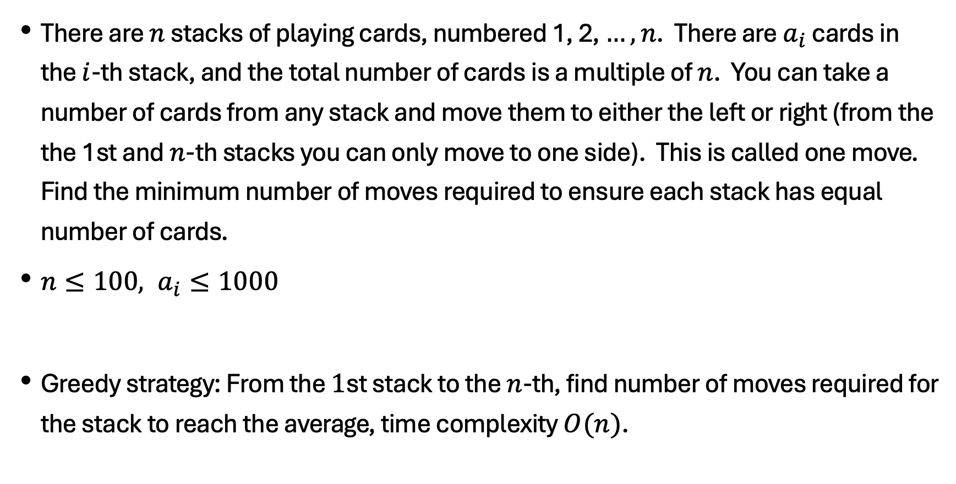
Divide the cards equally
There are $n$ stacks of playing cards, numbered 1, 2, $…,n$. There are $a_{i}$ cards in the $i$-th stack, and the total number of cards is a multiple of $n$. You can take a number of cards from any stack and move them to either the left or right (from the the 1st and $n$-th stacks you can only move to one side). This is called one move. Find the minimum number of moves required to ensure each stack has equal number of cards.
$n≤100, a_{i}≤1000$
Greedy strategy: From the $1$st stack to the $n$-th, find number of moves required for the stack to reach the average, time complexity $O(n)$.

Slide 10
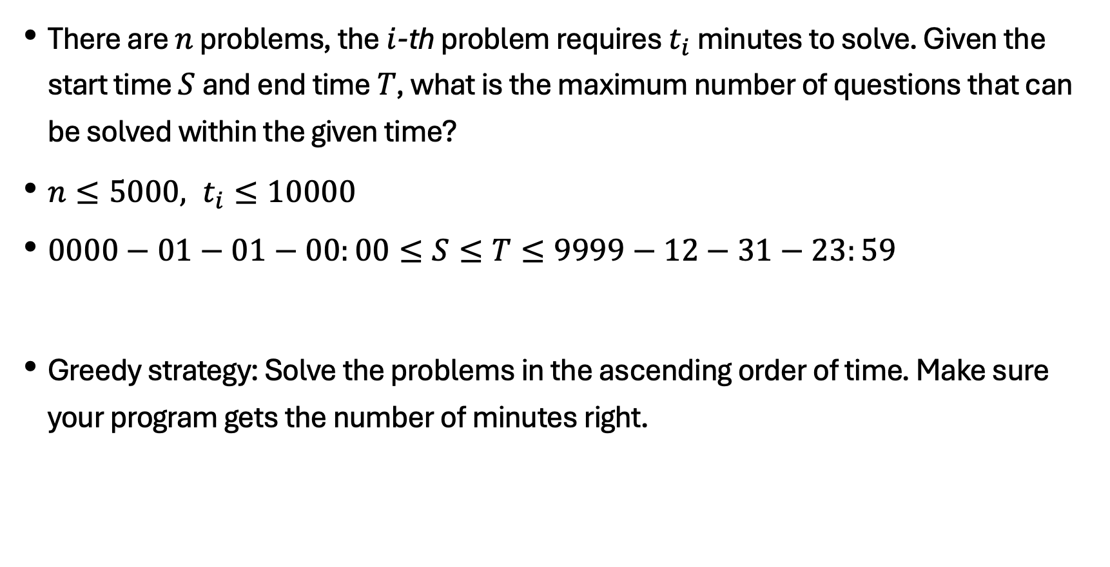
Solving problems
There are $n$ problems, the $i$-th problem requires $t_{i}$ minutes to solve. Given the start time $S$ and end time $T$, what is the maximum number of questions that can be solved within the given time?
$n≤5000, t_{i}≤10000$
$0000−01−01−00:00≤S≤T≤9999−12−31−23:59$
Greedy strategy: Solve the problems in the ascending order of time. Make sure your program gets the number of minutes right.

Slide 11
Thank you everyone.
Note: Please turn off your microphone and camera.
Mr. Gao's Algorithm
Competition Training Camp

